Slide 1
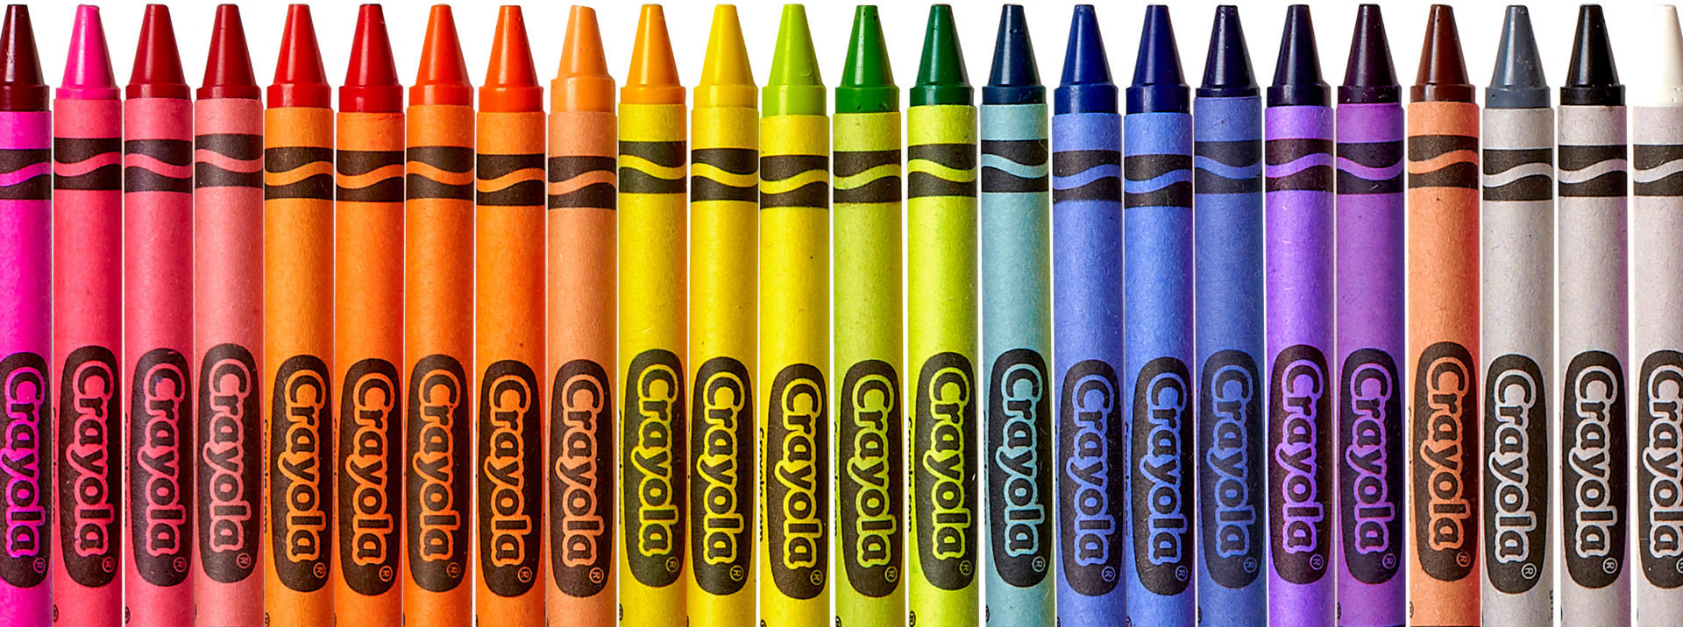
Helena Public Schools 2021-2022 Kindergarten Registration Process Begins January 4th, 2021, at your Neighborhood School
7:30am – 8:30am on Jan. 4th Drive Up drop off process (stay in vehicle, staff will pick up forms)
(Please wear masks and follow social distancing and local community health guidelines)
After 8:30am on Jan. 4th contact your neighborhood school via telephone to schedule drop off
(Please wear masks and follow social distancing and local community health guidelines)
Find your Neighborhood School by navigating to the following link and typing your address.
https://ewa.edulogweb.com/helenamt1web/webquery/WebQueryRequestController
You may also call (406) 324-2031 for assistance.
The Helena Public Schools will begin accepting kindergarten Registration Forms for the 2021/2022 school year on January 4th, 2021, beginning with a drive up (stay in your car) drop off of forms to staff from 7:30am - 8:30am. After 8:30am, contact your neighborhood school’s main office via telephone to schedule a time to drop off registration forms. In the days following, your school principal may schedule a remote spring conference with your family to complete the registration process.
Please have the completed Registration Forms and proof of current address (utility bill, lease agreement, etc.) ready to be dropped off/received by the building administrator beginning January 4th, 2021.
Registration Forms can be picked up from your neighborhood school prior to December 18th, 2021, or on the district website https://helenaschools.org/registration-and-enrollment/

